Slide 1


E1 201 : HAOML 2022 Course Project An efficient implementation of BCI EEG Net
Submitted by
Hitesh Pavan Oleti (19804)
Anand Chauhan (19744)
Guided
by
Dr. Chetan Singh Thakur

Slide 2
Problem Definition
Project Title: An efficient implementation of BCI EEG net architecture
Objective:
Implement the EEG Net on Arduino Nano 33 BLE Sense Lite kit.
Application: Classification of audio and visual EEG signals
Implementation details:
Google Colab: Modify and optimize the EEG Net to be compatible with the given hardware and generate the quantized and non-quantized model files.
MATLAB: Send and receive test data through UART
C++: Design the preprocessing block and setup to load the TensorFlowLite model.

Slide 3
Hardware and Dataset
Hardware used for inference
Ardunio Nano 33 BLE Sense Lite
Software used for Training, Serial communication
Google Colab
MATLAB
Dataset used
MNE-Python: a package for exploring, visualizing & analyzing EEG data
EEG dataset used for BCI
Details:
Dataset is a 288*60*151 multidimensional array: 288 samples
Each samples is 60*151 floating point numbers
4 Output labels : one-hot encoded (1-out-of-4 is 1, rest are 0)
Audio_Left , Audio_Right , Visual_Left, Visual_Right

Slide 4
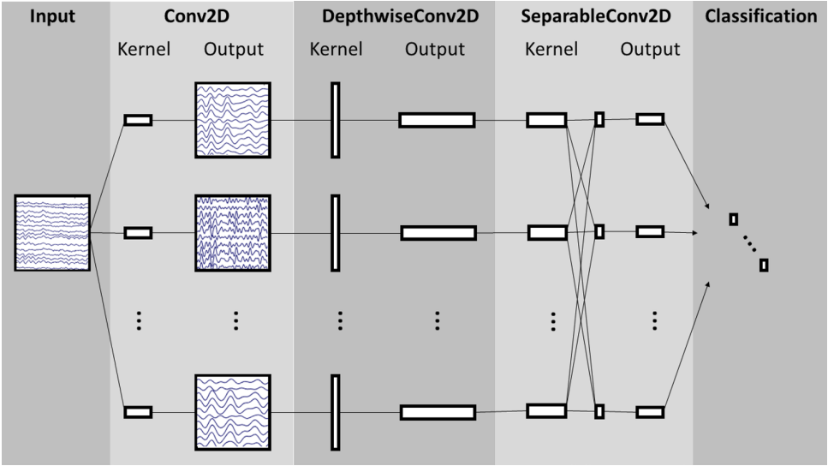
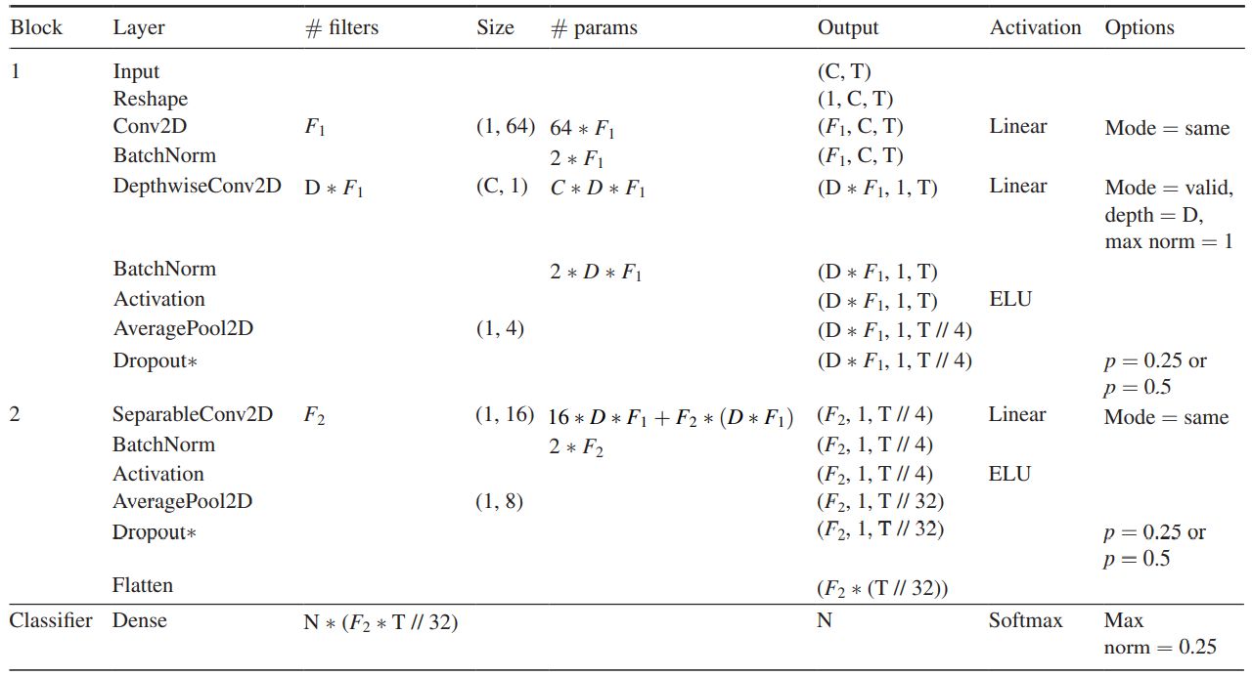
Details of the network
Overall visualization of the EEGNet architecture
Parameters:
C = number of channels = 60
T = number of time points = 151
F1 = number of temporal filters = 8
D = number of spatial filters = 2
F2 = number of pointwise filters = 16
N = number of classes = 4
For the Dropout layer, we used
p = 0.5 for within-subject classification
p = 0.25 for cross-subject classification

Slide 5
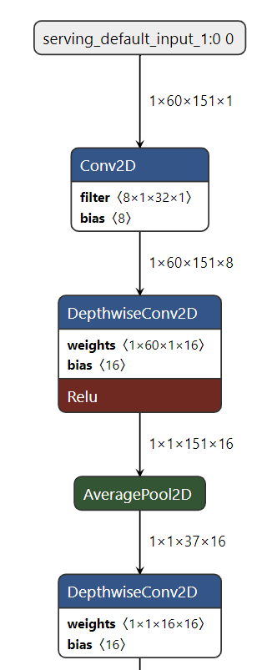
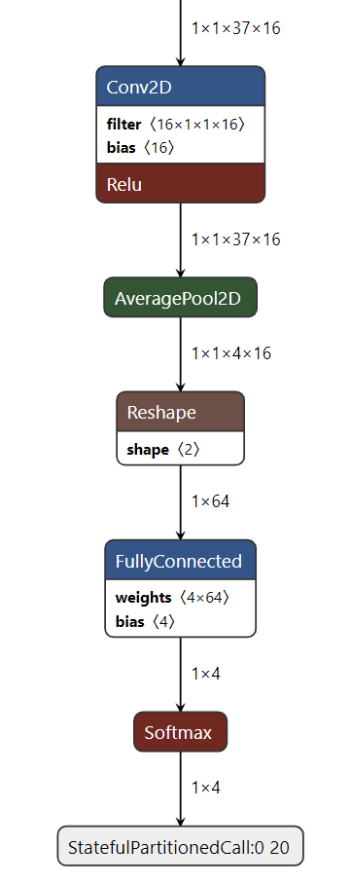
Details of the network

Slide 6
Pre-processing & Post-processing
Preprocessing:
Custom Filter Design for better noise removal
Designed a 5th order Elliptic IIR filter
Fixed point conversion of input float data to reduce the storage requirements, and to achieve low power and low latency
16-bit fixed point conversion with 15 bits for fraction part (normalized data)
Implementation of preprocessing block on Arduino
Packing the two unpacked bytes of input received from MATLAB
Pass the packed data through IIR filter
Performing Quantization on filter outputs
Efficient implementation of it with less memory footprint by reusing the variables effectively
Post-processing:
Dequantize the quantized predicted labels to get the exact SoftMax layer outputs

Slide 7
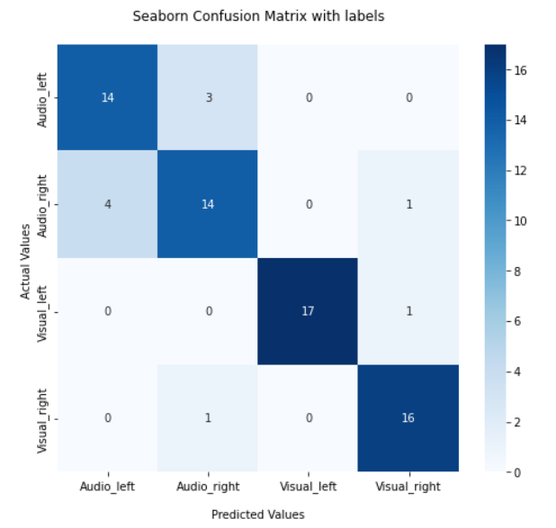
Results
Training accuracy : 99.31%
Testing accuracy :
Quantized model:
On Software: 90.64%
On Arduino : 90.64%
Non-Quantized model:
On Software: 91.08%
On Arduino : 91.08%
Confusion matrix:
Model | EEG Net
Dataset | MNE – EEG data set
Technology currently used to implement | MATLAB, Google Colab, C++
Hardware | Arduino Nano 33 BLE Sense Lite
Input dimension supported | 1*60*151
Number of input channels | 60
Sampling rate | 151
Layers supported | Conv2d, DW, PW, GAP
Output classes | 4 (Audio_left, Audio_right, Visual_left, Visual_right)
# Quantized model parameters | 8256
# Non - quantized model parameters | 12216
Dynamic memory usage of Global variables | 175.5 KB (68%)
Dynamic memory available for local variables | 80.5KB (32%)
Program storage space used by Sketch | 251.85KB (26%)

Slide 8
Observation
TensorFlow Lite does not support all type of layers, activation functions
Need to select best suited from the available sets (ELU -> RELU)
Pointwise, Separable layers -> not supported in Tflite
Fixed point conversion limits the accuracy
Int8 format : significant accuracy drop → go for Int16 format
Using UART to send each samples enables testing of any number of samples in a single go and squeezes the storage requirement to one data sample (18120B)
Handling Serial port reading time out errors by clearing and reassigning serial port
Pre-processing block on hardware
Memory constraints → Effective reuse of memory assigned previously

Slide 9
Standout features/ Work
Training novelty → Use of DS-CNN for reducing computational cost
Tiny Model (Quantized model size = 9 kB), yet highly accurate (more than 90%)
Custom Filter Design for better noise removal
Designed a 5th order Elliptic IIR filter
Fixed point conversion of input data to reduce the storage requirements, and to achieve low power and low latency
Implementation of preprocessing block on Arduino
Efficient implementation of it with less memory footprint by reusing the variables effectively
Sending and receiving the data through UART enables testing of any number of samples in a single go and squeezes the storage requirement to one data sample
Interactive GUI for better visualization, input-output
LED indication on Arduino to check the classified output

Slide 10
Future work
Extend this architecture for other datasets
MindBigData (MNIST of Brain signals)
1,207,293 brain signals of 2 seconds each,
seeing a digit (from 0 to 9) and thinking about it
End-to-end flow
Give input directly from EEG Electrode cap kit
Hardware implementation of the preprocessing (filtering and feature extraction) and BCI decoder blocks.

Slide 11
References
EEGNet: a compact convolutional neural network for EEG-based brain–computer interfaces
https://iopscience.iop.org/article/10.1088/1741-2552/aace8c/pdf
An Efficient Model-Compressed EEGNet Accelerator for Generalized Brain-Computer Interfaces with Near Sensor Intelligence
https://ieeexplore.ieee.org/stamp/stamp.jsp?tp=&arnumber=9925579&tag=1
MEG/EEG analysis with MNE-Python
https://mne.tools/dev/auto_tutorials/intro/10_overview.html

Slide 12
Team Members Contribution
Anand:
Development of Model in Colab for training
Data Visualization
Model parameters tweaking to get high accuracy
Generation of Quantized and non-quantized model Hex files
GUI development
Hitesh:
MATLAB codes:
Custom Filter Design for better noise removal and fixed-point conversion of input
Sending and receiving the data through UART and finding accuracy based on the prediction received from Arduino
Arduino Codes:
Implementation of preprocessing block on Arduino
LED indication on Arduino to check the classified output

Slide 13
Thank you!

